Slide 1
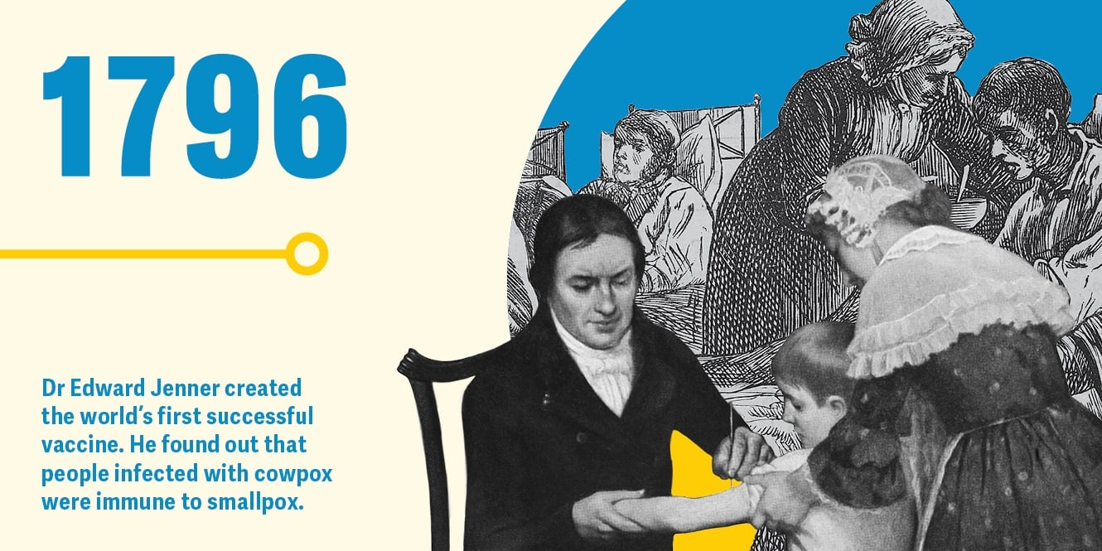
Edward Jenner
James Phipps

Slide 2
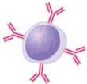
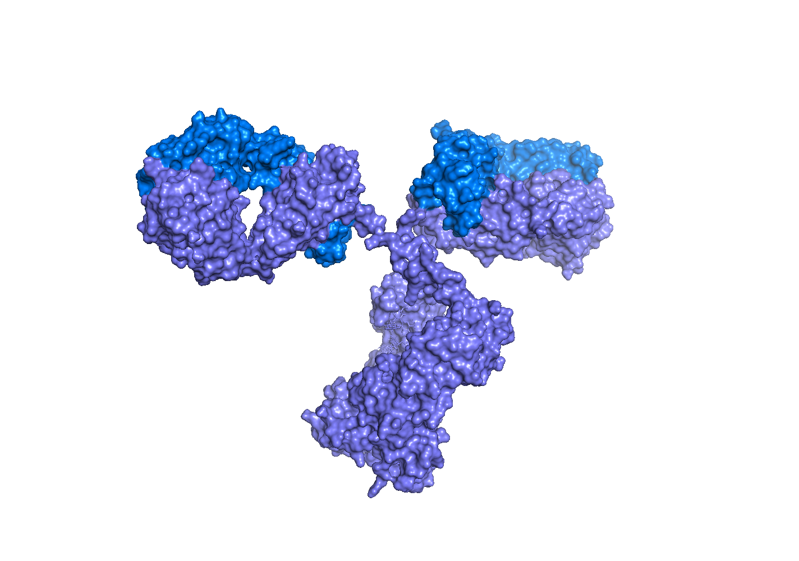
B cell development and B cell response a.k.a. B cells and antibodies
Pavel Tolar UCL Institute of Immunity and Transplantation
Notes:
intro

Slide 3
B cells and antibodies
Intro
B cell development
B cell activation
Germinal centre
Antibody recognition of pathogens
Antibody effector function and memory

Slide 4
B cells and antibodies Introduction Why is humoral immunity important?
Pavel Tolar Institute of Immunity and Transplantation
Notes:
intro

Slide 5
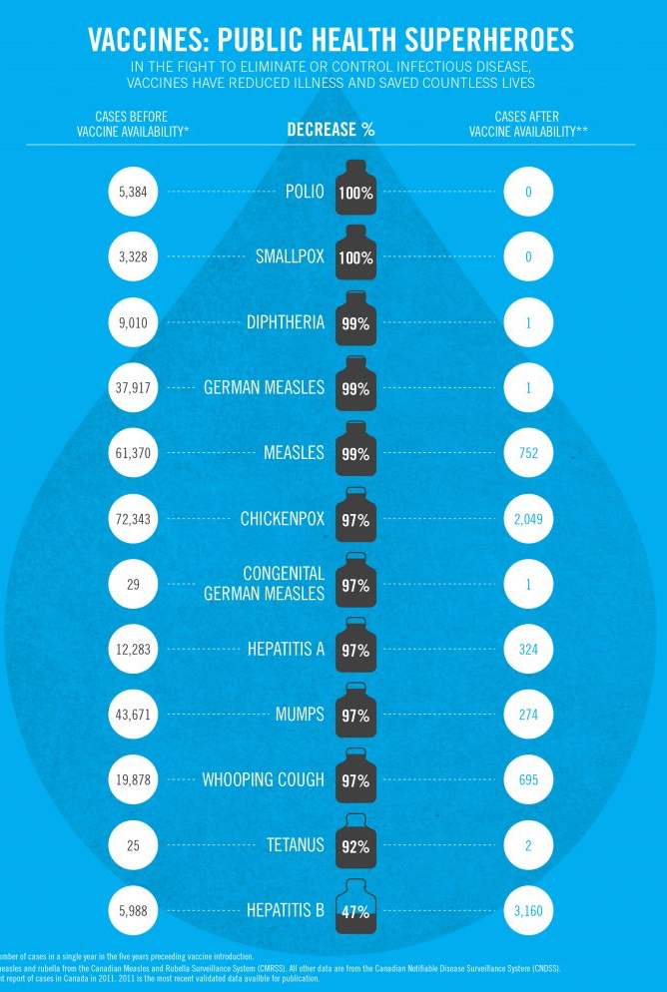
Why is humoral immunity important?
1. Vaccines
2nd largest impact on mortality (after clean water)
Trigger humoral immunity and produce protective antibodies

Slide 6
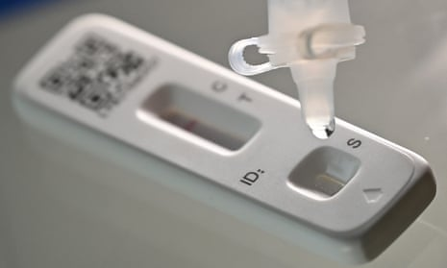
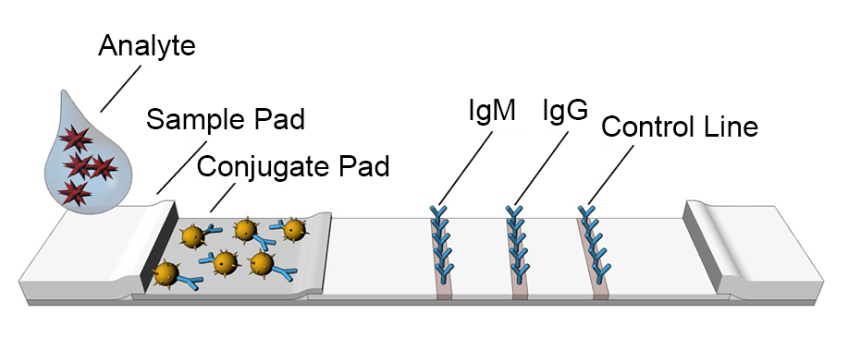
Why is humoral immunity important?
2. Antibodies as molecular tools
Diagnostics:
Viral infections
Autoimmunity
Cancer biomarkers
Pregnancy tests
Lab tools
Lateral flow test

Slide 7
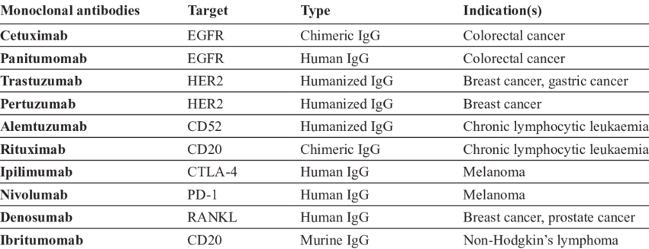
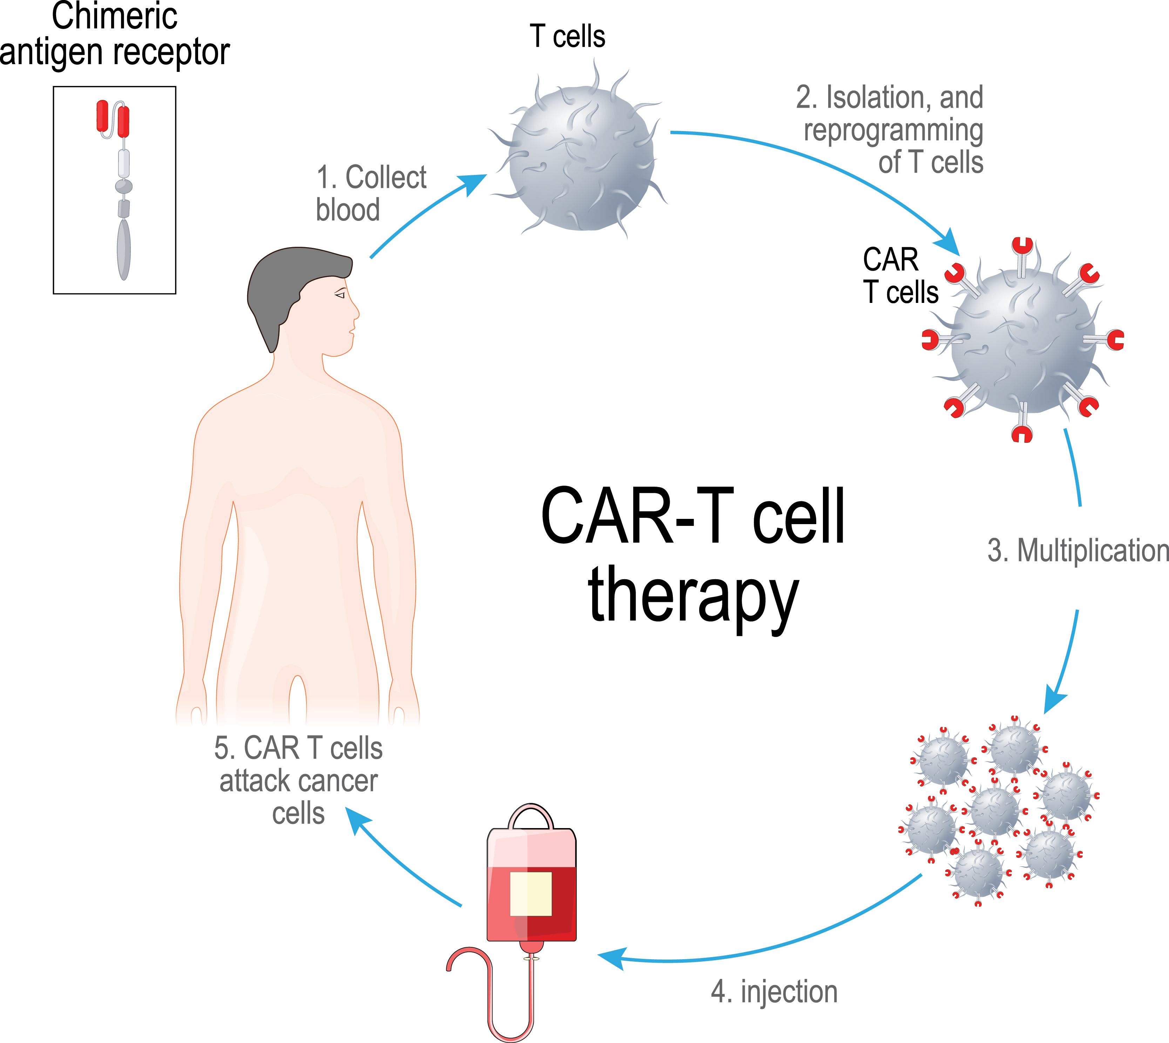
3. Antibodies as new therapeutics – “Biologicals”
Why is humoral immunity important?
Purified antibodies or conjugated to drugs
Parts of CAR-T cells
.
.
.

Slide 8
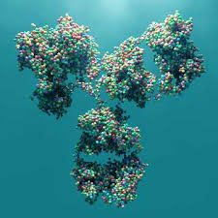
What is an antibody?
Binds to targets (Antigens)
Binds to targets (Antigens)
Recruits effector immune molecules and cells

Slide 9
What are the structural components of an antibody?
Immunoglobulin – Ig
Encoded by 2 blocks (loci) of DNA within the genome:
Heavy chain and light chain loci
2 transcripts => 2 polypeptide chains translated
Co-expressed and bind together covalently

Slide 10

Antibodies are produced by B Cells
Antibodies are produced by lymphocytes of the B cell lineage
B cell receptor (BCR) is the first form of the Ig expressed as a membrane form on B cell surfaces
Antibody is the soluble secreted form of Ig, produced by B cells differentiated into plasma cells
B cells – BCR
Plasma cells - antibody

Slide 11
B cells: 3 major functions
1. Antibody production
2. Cytokine secretion
3. Antigen presentation

Slide 12
Learning objectives
Intro: ✔ Describe the structural components that make up an antibody molecule and the function of each part
B cell development: Explain the role of B cell development in the generation of the antibody repertoire and describe the underlying molecular mechanisms
B cell activation: Describe the signals that drive clonal B cell responses and differentiation into antibody-secreting cells
Germinal centre: Explain what germinal centres are and how they improve antibody affinity
Antibody recognition of pathogens: Explain why multi-component assembly is a critical factor in producing effective antibodies
Antibody effector function and memory: Explain how antibody responses protect from pathogens

